Slide 1

RAJARAJESWARI COLLEGE OF ENGINEERING #14 Ramohalli cross,Kumbalagodu,Mysore Road,Bengaluru-74 Department of Artificial intelligence and machine learning 21AIMP69 – Mini Project Project presentation on Smart Mouse : Interaction with Gesture
Under the guidance of: Aishwarya M G (1RR21AI004)
Dr. Rajesh K.S Abhishek B O (1RR21AI002)
HOD and prof. of AIML dept Vijayalakshmi .V (1RR21AI063)

Slide 2
Gesture Controlled Virtual Mouse :
Gesture Controlled Virtual Mouse makes human computer interaction simple by making use of Hand Gestures.
The computer requires almost no direct contact.
All i/o operations can be virtually controlled by using static and dynamic hand gestures.
This project makes use of the state-of-art Machine Learning to recognize hand gestures which works smoothly without any additional hardware requirements.
It consists of two modules:
One which works direct on hands by making use of MediaPipe Hand detection.
Pyautogui , which is used to mouse control and access.

Slide 3

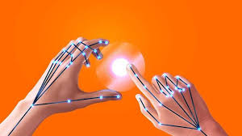
METHODOLOGY:- 1. Utilizing MediaPipe for hand detection. 2. Using OpenCV and Python for image processing and system integration. 3. Implementing Pyautogui , pynput mouse for mouse control and access. SOFTWARE REQUIREMENTS:- Programming Language: Python (version 3.8.5) Libraries and Frameworks: MediaPipe , OpenCV, Pyautogui , pynput mouse Developed Environment: Visual Studio This structured approach ensures that the project not only achieves its goals but also provides a seamless user experience through the integration of gesture.

Slide 4
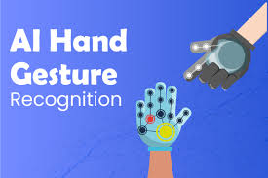
Features :
Gesture Recognition:
Neutral Gesture
Move Cursor
Left Click
Right Click
Double Click
Screenshot

Slide 5
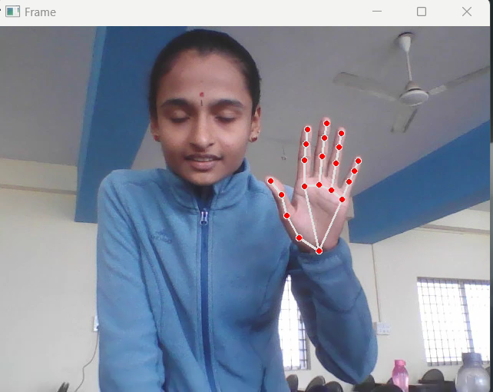
Neutral Gesture :
Gesture control is the ability to recognize and interpret movements of the human body in order to interact with and control a computer system without direct physical contact.
Gesture coding manual describes our methods for gesture labeling, labeling them for their movement

Slide 6
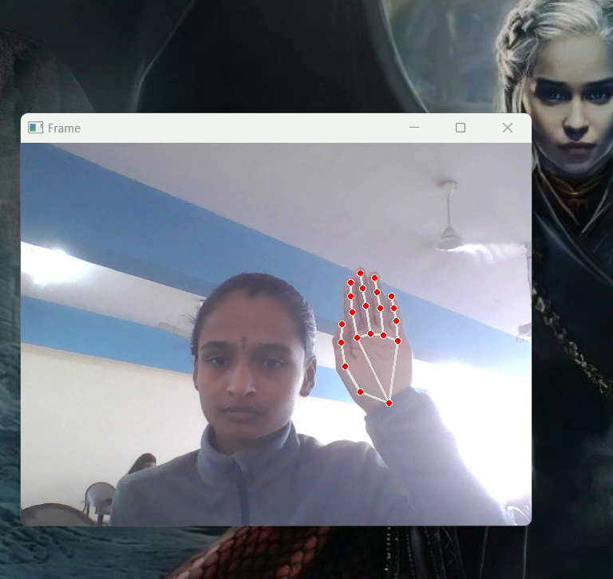
Move Cursor :
Cursor moving: Raise all fingers together and move your hand to move the cursor and control it.
Cursor freezing: Open your thumb and Raise all other fingers together freeze the cursor and prevent it from moving.

Slide 7
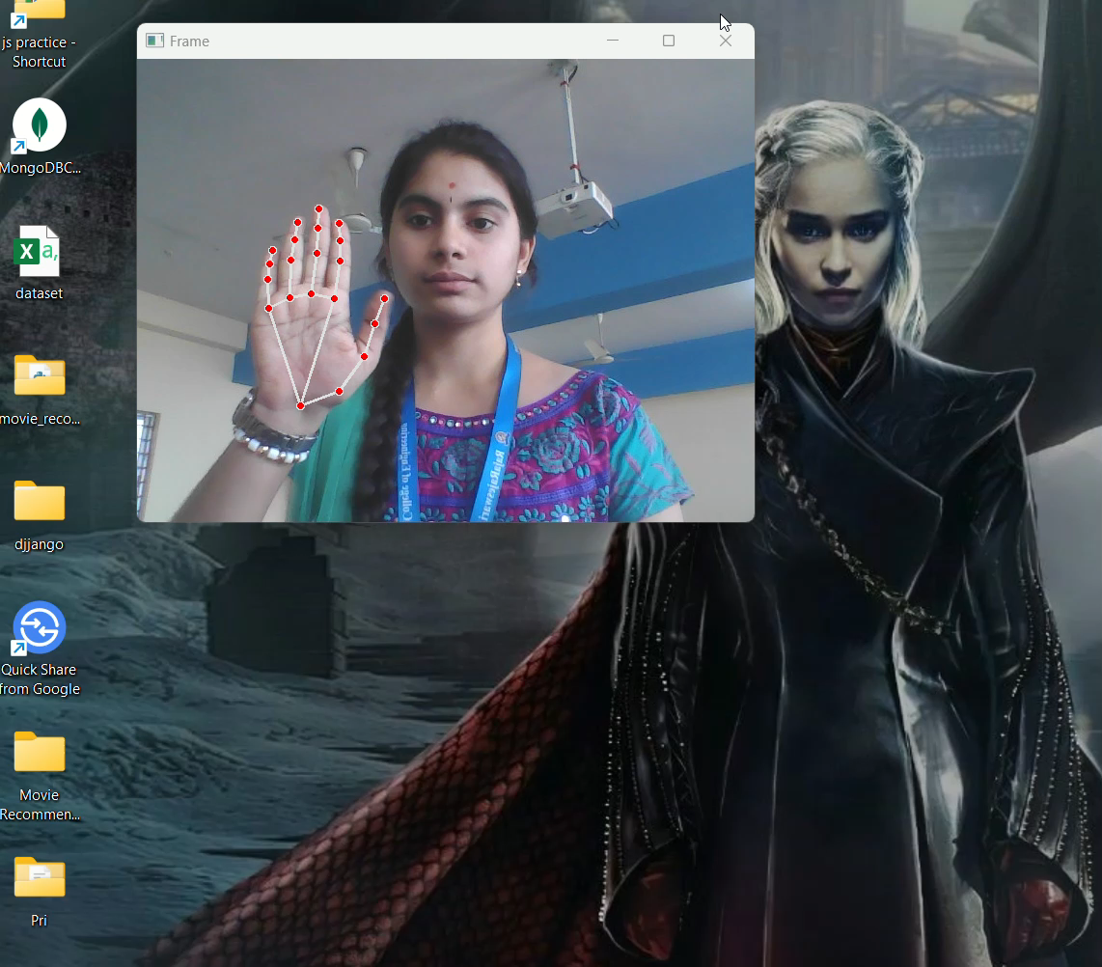
Left – Right and double Click :
A pointing device gesture or mouse gesture is a way of combining pointing device or finger movements
And clicks that the software recognizes as a specific computer event and responds to accordingly.
Left click : Index Finger
Right click : Middle Finger
Double Click : Both index and middle finger

Slide 8
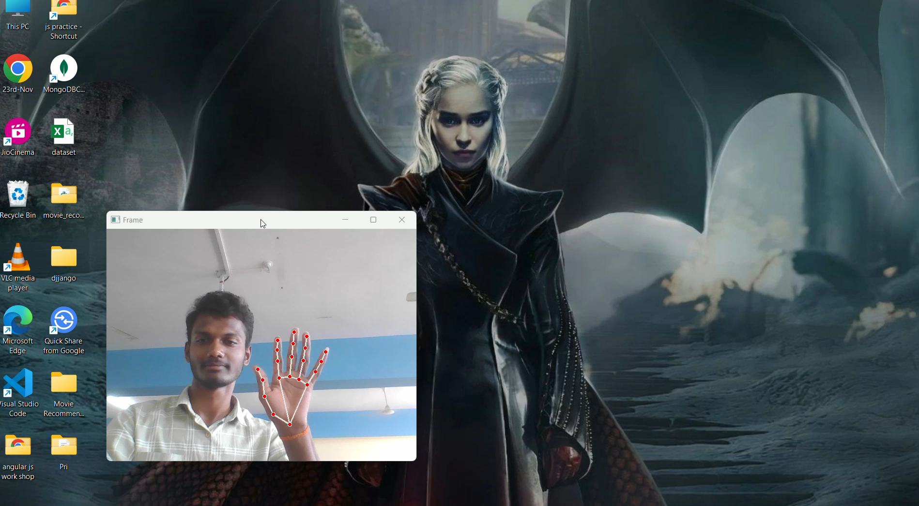
Screenshot:
Detect hand pose
Check finger angles
Capture on condition :This code captures a screenshot when all fingers are closed, indicated by angles < 50

Slide 9
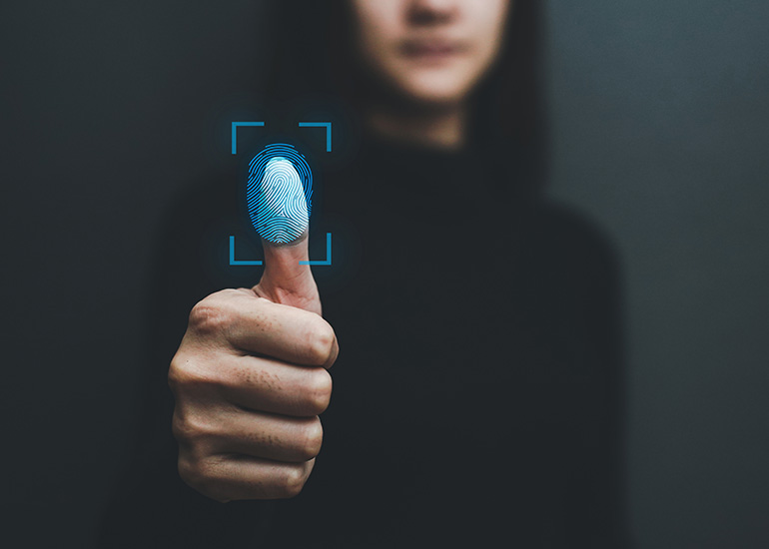
THANK YOU

